Slide 1


Aura Aesthetic : Beauty Salon and Studio

Slide 2
Prepared By :
Name : Priyanshi Modi
Roll no : 29
Department : SY3 C1
Enroll no : 23002170210063

Slide 3
Understanding Today's Online Customer Journey
Clients start their journey online. They research local salons, look at photos, read reviews, and compare pricing.
Clients expect a seamless online experience. They want to book appointments easily, manage their bookings, and stay informed about promotions.

Slide 4
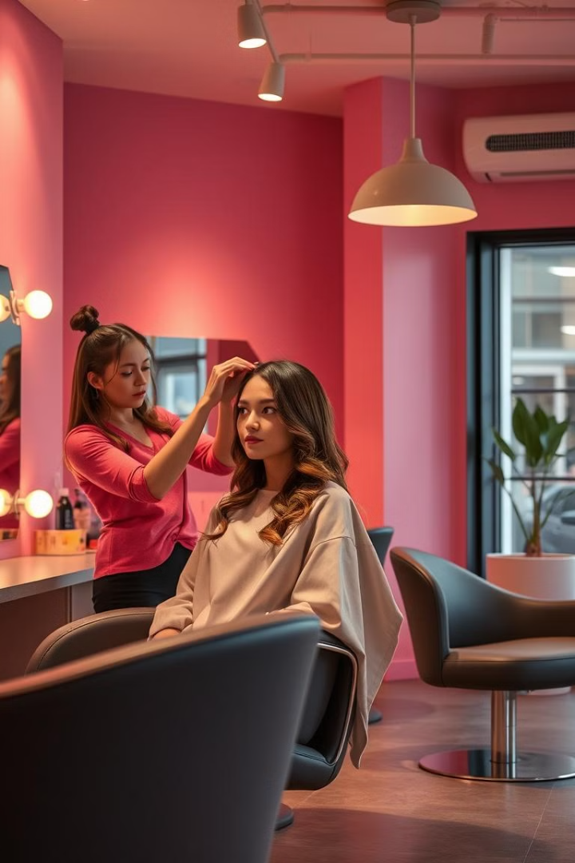
Elevate Your Salon: A Modern Digital Experience
A website is essential for any salon today. It's your online storefront, where you can connect with new clients, showcase your expertise, and drive bookings.

Slide 5




Technology Used :
HTML
CSS
JAVASCRIPT
BOOTSTRAP

Slide 6
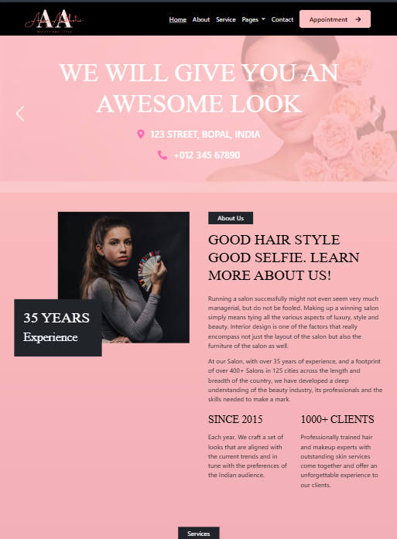



Salon Website Design: Clean, Intuitive, Professional
Mobile-first design: Clients browse on phones.
Clear visuals: Showcase salon atmosphere and stylists' work.
Easy navigation: Clients find information quickly.

Slide 7
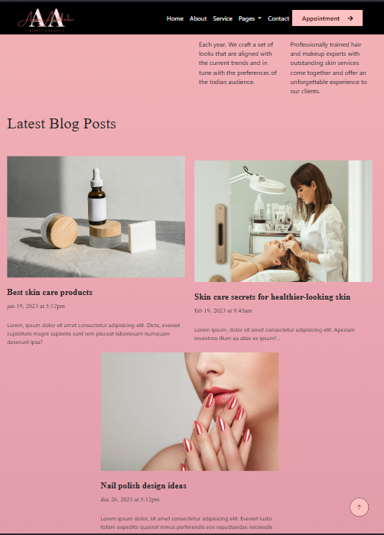
Responsive Design for Mobile and Desktop Platforms
1
Consistent user experience across devices.
Optimized for mobile browsing and booking.
Website adapts to different screen sizes.
2
3

Slide 8
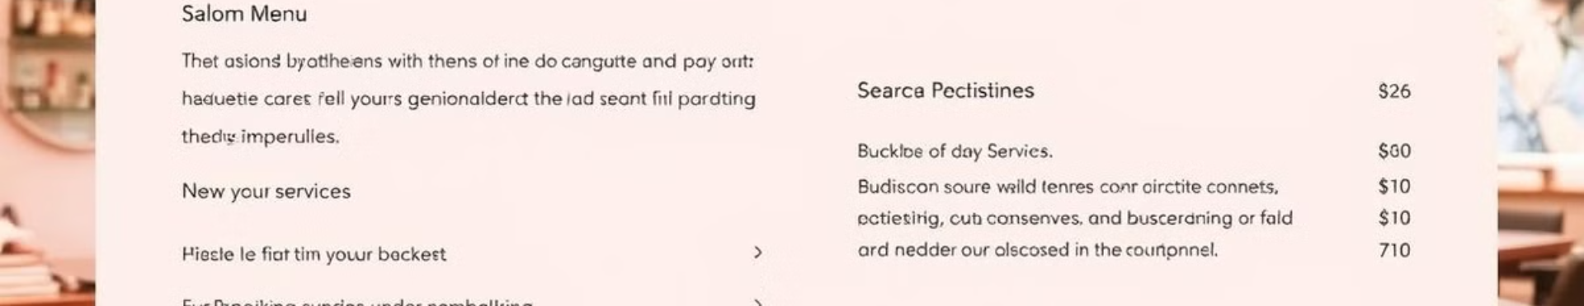
Service Menu and Transparent Pricing
Services
Pricing
List all available services and their descriptions.
Clearly display prices for all services.

Slide 9
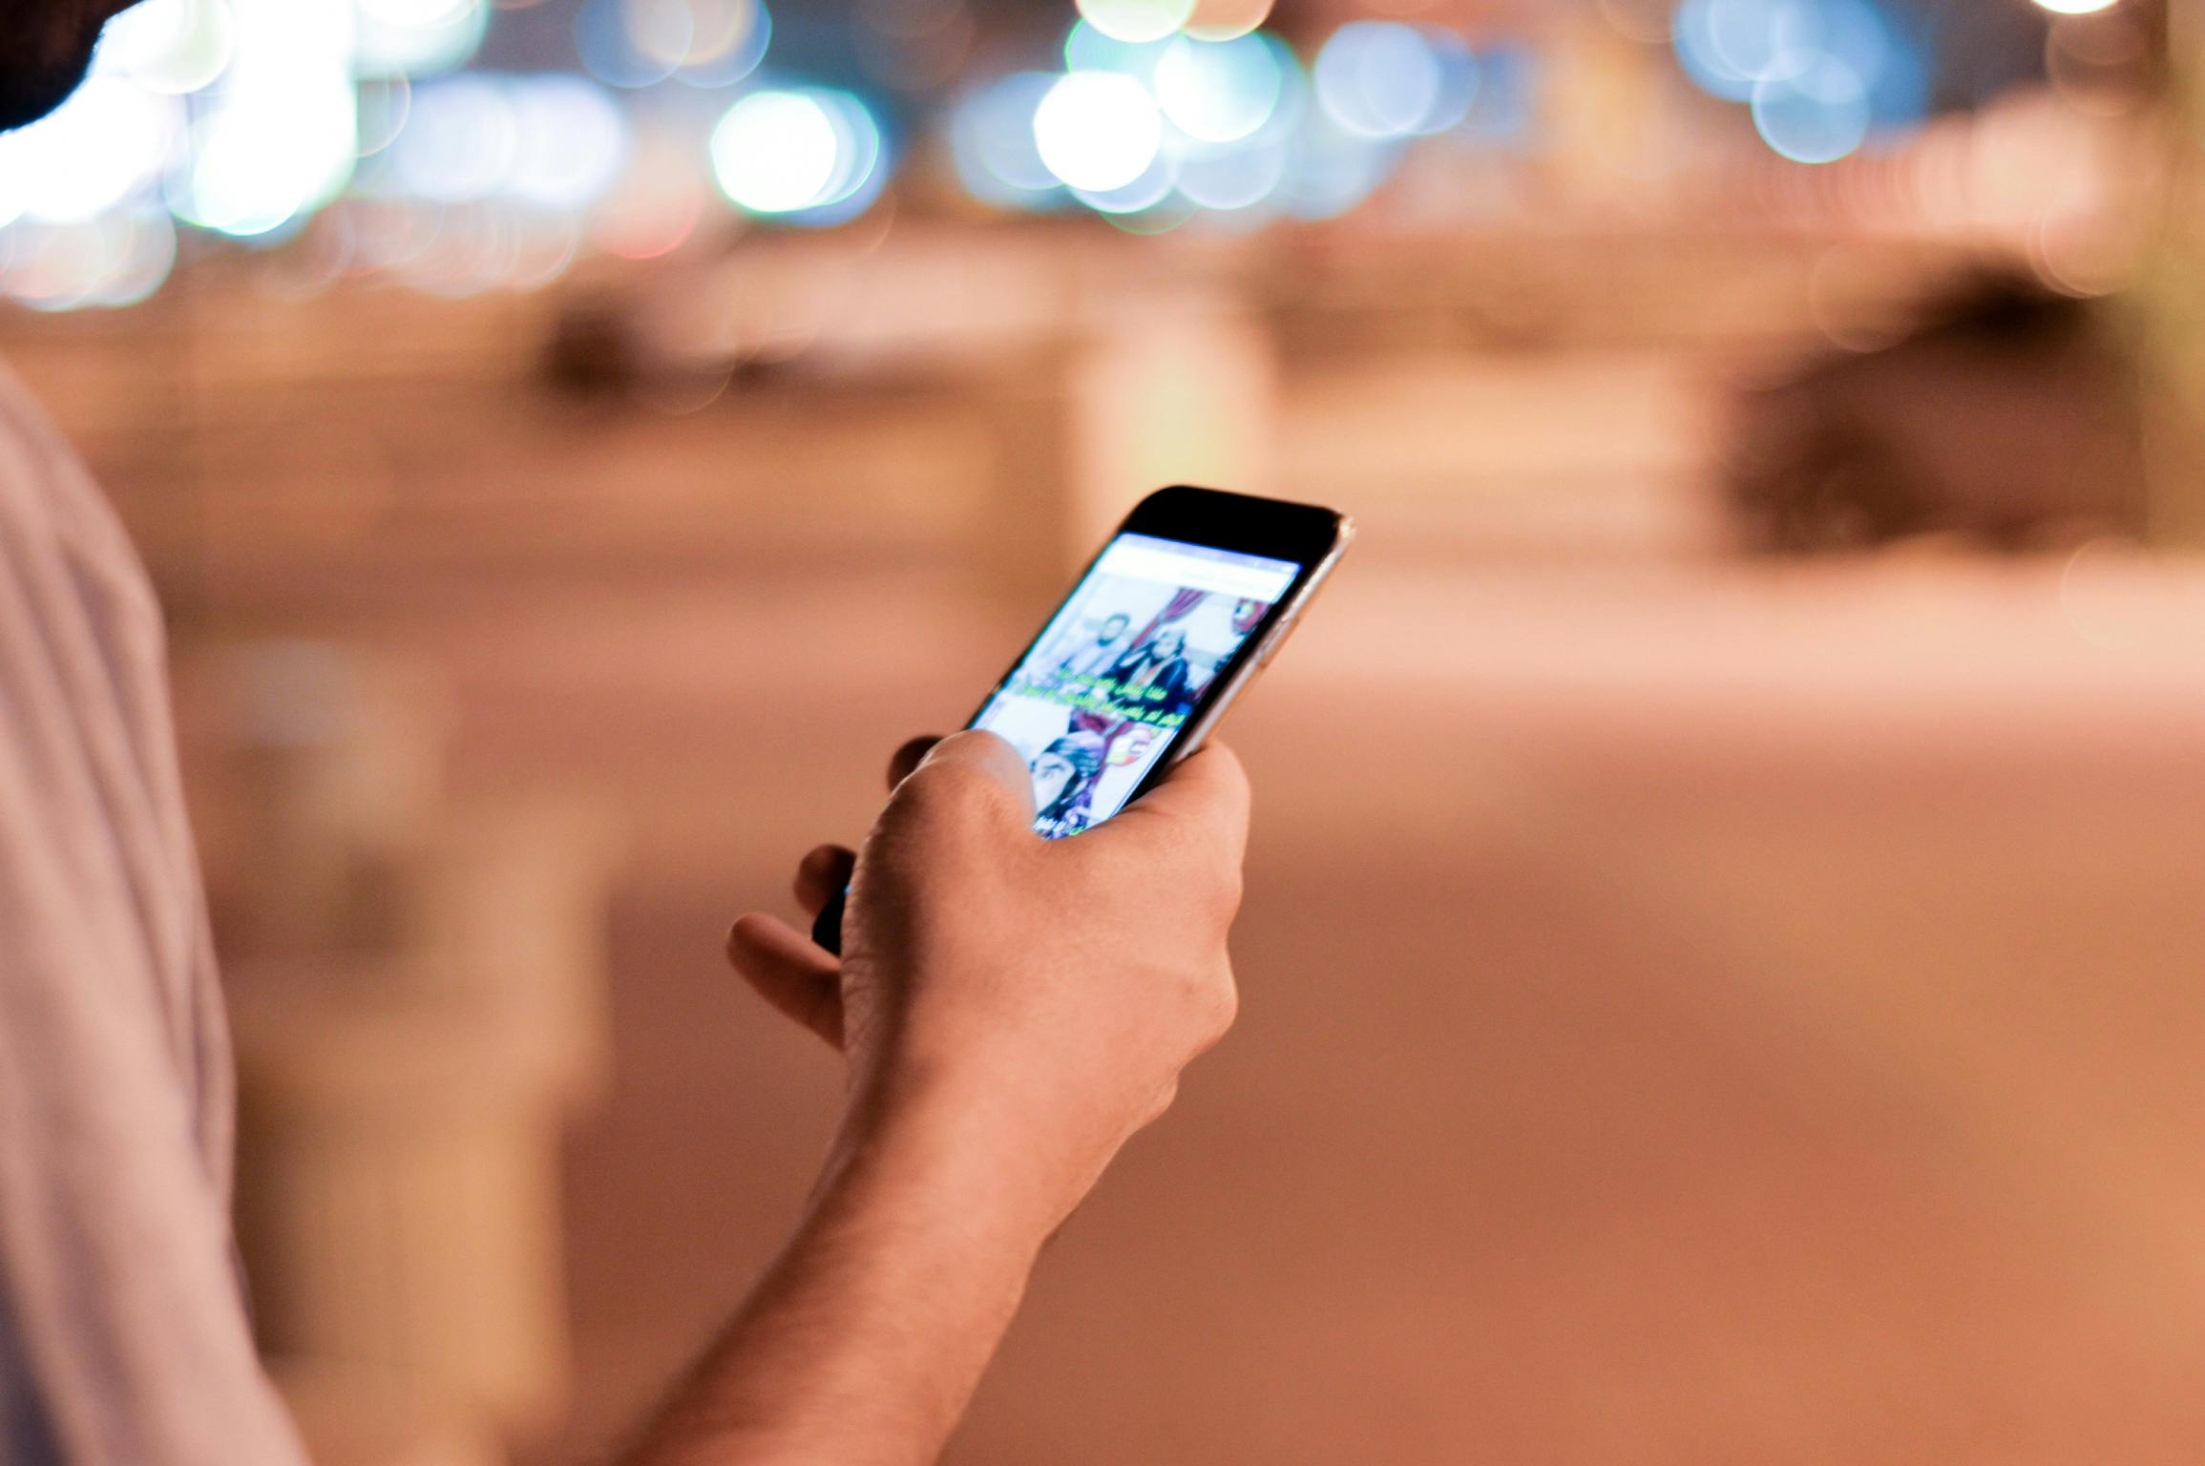
Functionalities :
Google Map Integration
AOS (Animate On Scroll)
Video Embedding
Owl Carousel
Online Booking Form

Slide 10
FUTURE SCOPE :
Convert into a Progressive Web App (PWA)
Improve UI/UX with Advanced Features
Use a Backend and Database
Enable Online Payments
Before and After Transition

Slide 11
Thank You!

